Slide 1
We have exam vouchers!!!
50% off for next 30 days
Please take the exam within the voucher activation window.
The voucher is tied directly to you and will be emailed directly to you right after the event.

Slide 2
We have free practice exams
Free Test Prep Voucher:
We are offering a test prep voucher to every attendee on a request basis only. Attendees will have to email skillupmsft@microsoft.com to receive their code after the event. They will receive a note about this in their Thank You email but please make sure this is something you promote at this event. Please note: There is a limited number of vouchers available. They are distributed on a first-come, first-served basis until all our vouchers have been requested.

Slide 3
Program Roadmap - So Far…Futures coming later
Certification Training (85% Pass Rate)
70-533 Implementing Azure Solutions
70-535 Architecting Azure Solutions
70-475 Big Data
70-774 Machine Learning
70-777 Cosmos DB
Linux on Azure (with Linux Foundation) Kicks off June 2018
Pilot Deep Dives
DevOps
Many Projects, many customers
Program Home: https://aka.ms/certup

Slide 4
Getting Started Labs https://docs.microsoft.com/en-us/azure/#get-started
Deploy infrastructure
Linux virtual machines
Windows virtual machines
Secure and manage resources
Azure Security Center
Azure Monitor
Azure Application Insights
Azure Cost Management
Azure Backup
Azure Site Recovery
Azure Migrate
Azure Policy
Develop apps
Manage data and AI
Relational Databases
SQL database as a service
SQL Data Warehouse as a service
PostgreSQL database as a service
MySQL database as a service
NoSQL
Azure Cosmos DB
Storage
Blob Storage
AI and Cognitive Services
Machine Learning
Cognitive Services
.NET Python Java | PHP Node.js Go
App Models
Web Apps
Serverless Functions
Containers
Microservices with Service Fabric
https://docs.microsoft.com/en-us/azure/#get-started

Slide 5
Voting: Show of Hands
How deep is your knowledge of Azure Cloud Solutions?
1. I know Azure and its offerings really well
2. I have a good base knowledge of Azure
3. I know some of Azure
4. I’m just getting started with Azure

Slide 6
Voting: Show of Hands
Are you planning on taking the Azure Certification Exam related to this content?
1. Yes
2. Maybe, I’m interested in finding out more
3. No

Slide 7
Voting: Show of Hands
Do you feel you are educationally ready to deliver Azure Solutions Now?
1. Yes, Ready to go
2. Maybe, after doing homework, I will be ready
3. No

Slide 8
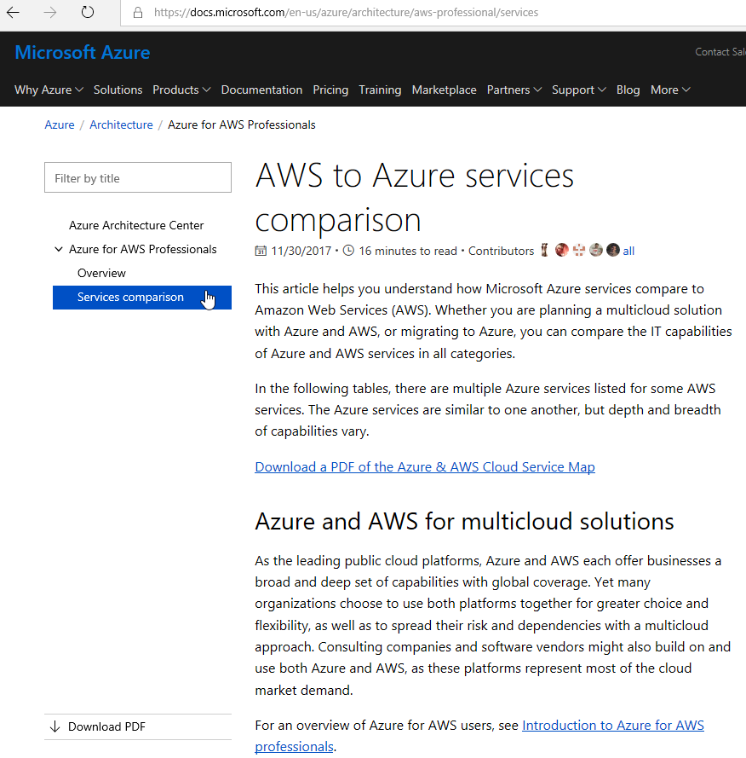
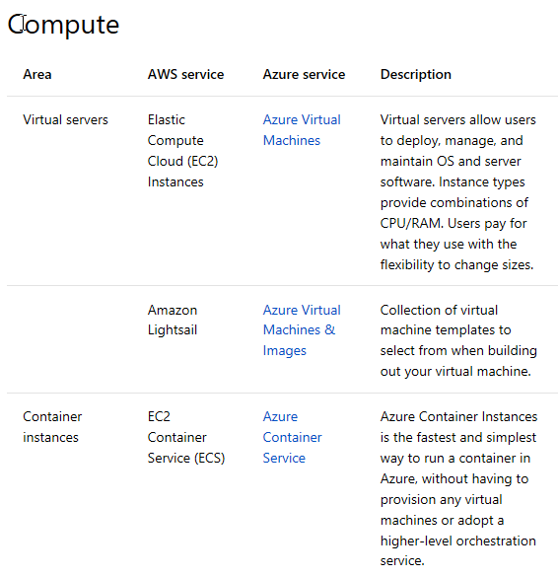
AWS to Azure Services Comparison
https://docs.microsoft.com/en-us/azure/architecture/aws-professional/services

Slide 9
Azure Capacity Planning

Slide 10

Good to know
Azure DOES have limits!! Per Azure Sub and even per Azure Region
Know the Service-specific quota limits - Limits
Some limits are a hard maximum, while others are a soft limit that can be increases upon request.
Involve your Microsoft Architects in planning…. EARLY!!!
You can increase quota!
“But I Thought Azure had Infinite Capacity?”
Limits are Good….Kinda
Limits help keep you cloud spending predictable by not allowing you to spin up the resources that could generate a huge monthly bill without you doing it on purpose. This save you and Microsoft money since they’d likely need to refund lots of cloud spending if all customers were allowed to go unchecked.
Limits help Microsoft throttle the growth of cloud usage; both within individual Azure Regions, as well as Globally across all their datacenter and regions. This allows Microsoft to ensure that individual customers aren’t able to overload any particular Azure Region or data center unexpectedly.
Be an Architect 535 Exam
January 2017

Slide 11

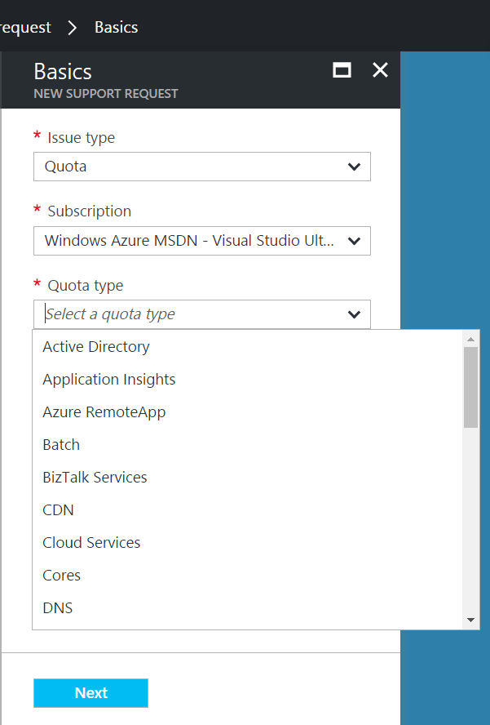
Good to know
Very large quota requests may take more than a day to be processed
Depending on how many cores are requested, a simple credit check initiated by the Support Team may be required
Recommended approach
Step 1: Visit the Azure Portal and click on ‘Help + Support’ and open a new support request.
Step 2: Click ‘Quotas’ under Issue Type and select the type of subscription for which you want to change the quota.
Step 3: Choose the resource type where you want to increase the quota.
Example 1: Increase number of cores
Example 2: Increase Storage
Step 4: Enter your preferred contact method and contact information and create the support case
“How do I increase Azure Quota?”
Support Type: Free Assisted - Billing
January 2017

Slide 12
Time For Feedback!

Slide 13
Show of Hands
Who feels like the knowledge you obtained in this class will help your company?

Slide 14
Show of Hands
Who feels like the knowledge you obtained in this class will help your career?

Slide 15
Do you want more free training for you, your friends and peers?
Feedback is very, very important to Microsoft. It is the mechanism we use to get additional funding to have more workshops.
Please help us help you & your peers, now and in the future. Give us the evidence that this is a worthwhile investment.
It only takes a couple minutes to fill out the survey at the end of the class. Even if you miss some of the class, it is very important that we get your feedback!
THANK YOU! From our entire training team!!!

Slide 16
Live Feedback: In your own words: What did you think of …
Please provide:
Contact First+Last Initial:
Company [optional]:
Event
Content
Speakers
Topics
Event Flow
Azure Capabilities
Training Leading to Cert
Workshop Model/Flow
Specific Azure Service
Value to You personally
Value to your company
Other

Slide 17
Feedback: Making the Most of the event Your Projects
What types of project(s) do you have or hope to drive where Azure may provide a solution?
Open Discussion
Project:
Contact First+Last Initial:
Company [optional]:
Can you benefit from help from Microsoft:

Slide 18
What can we do better?
Julio Cesar Cruz O
fiswar@hotmail.com
Please email jcruz@directionstraining.com

Slide 19
Evaluation Form Super Important. Please invest another 2 minutes now to fill out the event survey.
URL: https://tinyurl.com/535IL66

